Slide 1






DIGITAL CIRCUITS AND SYSTEMS LAB PROJECT 19CSE282
MEALY FSM SEQUENCE DETECTOR FOR SEQUENCE 111101

Slide 2



group j
S Abhishek - AM.EN.U4CSE19147
Rahan Manoj - AM.EN.U4CSE19144
Harsha Sathish - AM.EN.U4CSE19123
Arvind Kumar - AM.EN.U4CSE19109
Rohit Menon - AM.EN.U4CSE19146

Slide 3






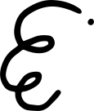


Welcome All

Slide 4

State Diagram
LETS LOOK INTO THE STATE DIAGRAM

Slide 5
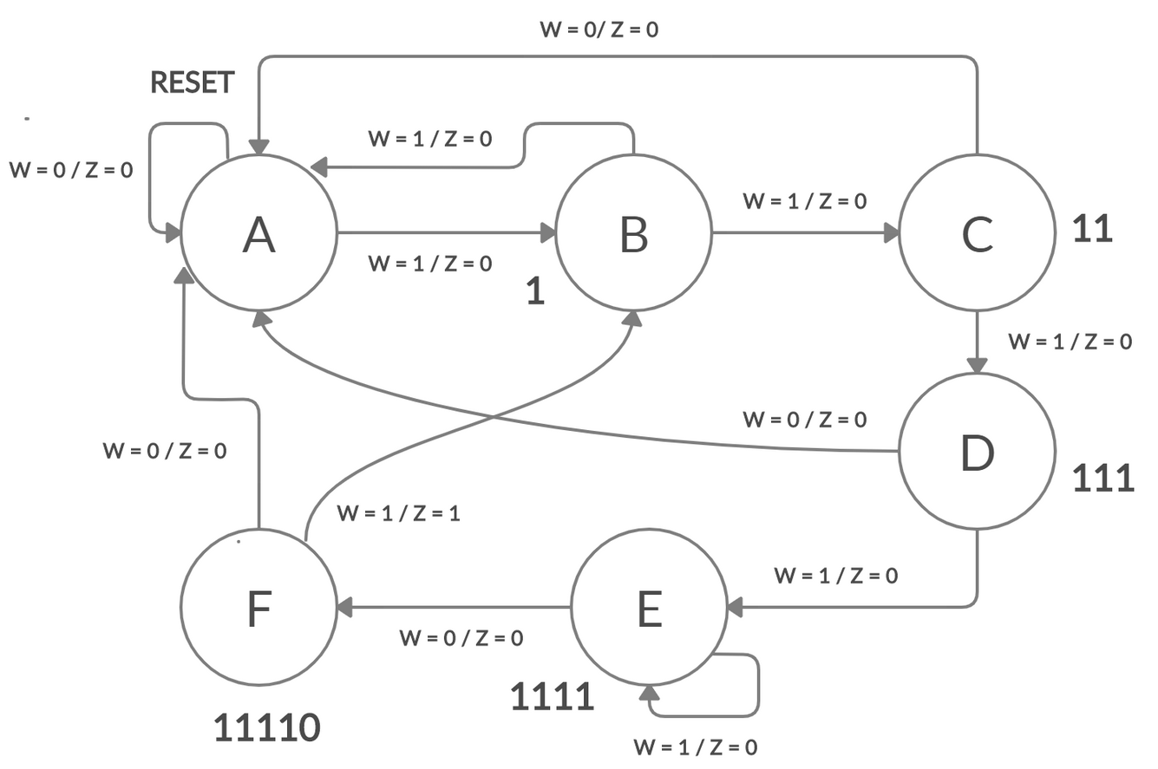

Slide 6
State Table

Slide 7
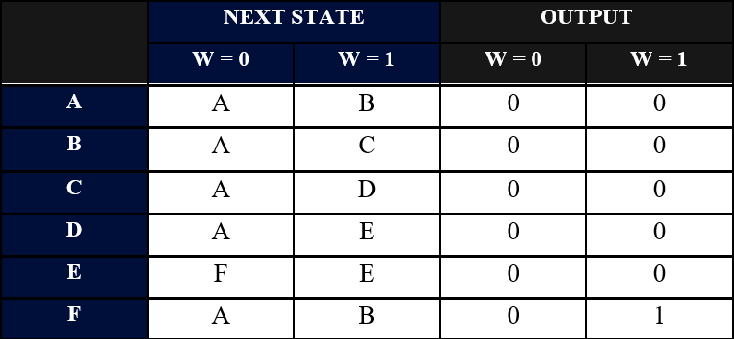

Slide 8
State Assigned Table

Slide 9
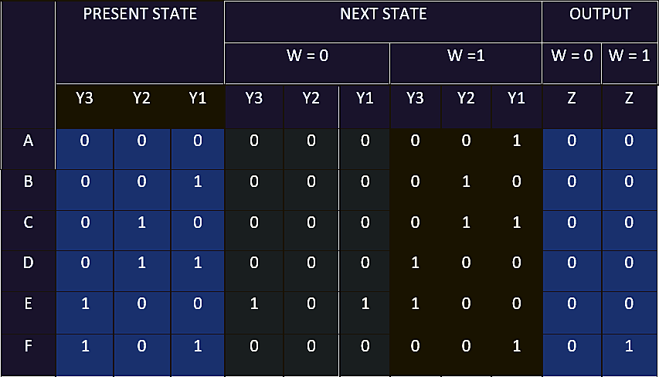

Slide 10
KMap

Slide 11
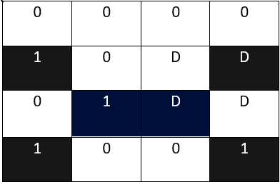
KMAP FOR Y1
Y1 = w’ y3 y1’ + y1 w y3 + y1’ w y3’
y2 y1
w y3
00
01
11
10
00
01
11
10

Slide 12
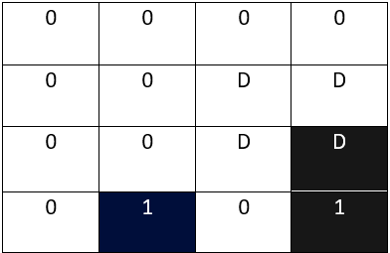
KMAP FOR Y2
Y2 = y1 y2’ y3’ w + w y2 y1’
y2 y1
w y3
00
01
11
10
00
01
11
10

Slide 13
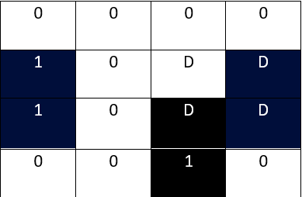
KMAP FOR Y3
Y3 = y1’ y3 + w y1 y2
y2 y1
w y3
00
01
11
10
00
01
11
10

Slide 14
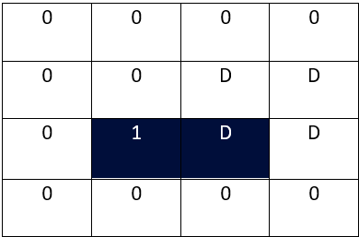
KMAP FOR Z
Z = w y3 y1
y2 y1
w y3
00
01
11
10
00
01
11
10

Slide 15
Circuit Diagram

Slide 16
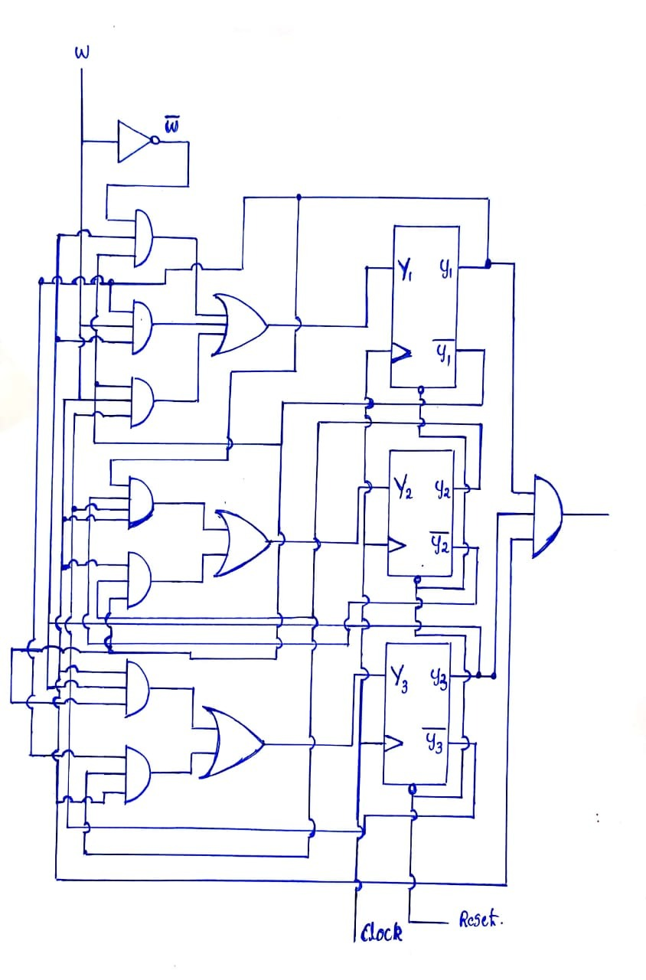

Slide 17
Tinker CAD Implementation

Slide 18
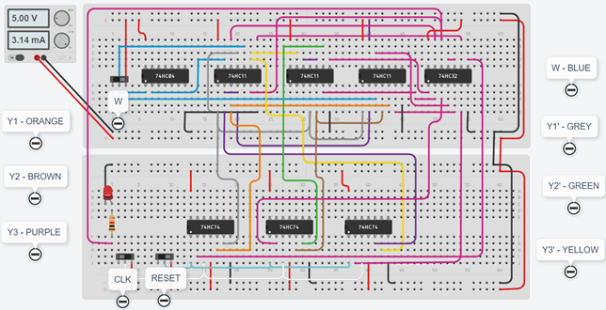

Slide 19



Thankyou

